Slide 1


Understanding Storage Systems and SQL Server
Wes Brown
#58 Houston

Slide 2

What we are going to learn
This is a quick dive into your servers IO DNA. We will cover…
Base System Makeup
  System Buses
  Peripheral Buses
Disk Controllers, Host Bus Adapters, and Interfaces
  Disk Controller basics
  HBA’s
  Interface speeds
The Basics of Spinning Disks
  Physical Structure
    Track placement
    Disk Speeds
      Latencies
      Random vs. Sequential IO
      Disk Queuing
Solid State Disks
  SSD vs. Hard Drive
  SSD form factor and performance
Redundant Array of Inexpensive Disks
  RAID 0
    No Protection!
  RAID 1
    Limited Space
  RAID 0+1
    Limited Protection
    Speed
  RAID 10
    Best Protection
    Best Speed
  RAID 5
    Limited Protection
    Most Capacity
  RAID 6
    Better Protection
    Slow
  Space or Performance?
  Configuring Your Array
  Managing Disk Failures
  Stripe Size, Block Size, and IO Patterns
Basics of SAN’s
  Shared Storage
  Capacity not speed
SQL Server and The File System
  ACID and WAL
  Stable Media
  FUA
  File Access
File System Configuration
  Align Partition
  64KB Cluster Size
SQL Server Files
  Data Files
    8KB / 64KB
    Random IO
    Log Files
    512 Byte / 8KB +
    Sequential IO
Solid State Disks
  SSD vs. Hard Drive
  SSD form factor and performance

Slide 3
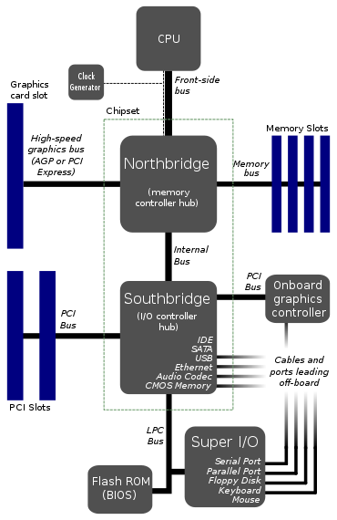
System Buses
The modern server is made up of several buses or controllers that talk to each other and to the CPU.
Front-side Bus
  Usually, memory only access
  Fastest bus on system
  Hypertransport/Quickpath replacing FSB
I/O Controller/Bus
  Also known as the peripheral bus
  All onboard devices
  All expansion slots

Slide 4
Peripheral Buses and Speeds
Bus Type | Speed MB/Sec
PCI 32-bit/33 MHz | 133
PCI-X | 1066
PCI Express x1, 4, 8, 16 | 250, 1000, 2000, 4000
PCI Express 2.0 x16, 32 | 8000,1600
PCI Express 3.0 x16 (2011~) | 32000
Always use the fastest bus possible for your disks.
Some buses are shared (pci-x).

Slide 5
Disk Controllers, Host Bus Adapters, and Interfaces
Drive caches 2MB to 64MB+
  Adaptive Segmentation
  Pre-Fetch
RAID Host Bus Adapters
  Read caching
  Write caching !WARNING!
    Hardened writes
    Pay now or pay later
    Writes take precedence over reads
    16GB buffer pool vs. 256 MB IO cache, you do the math

Slide 6
Interface Speeds
Bus Type | Speed MB/Sec
ATA/133 | 133
SATA/SAS 150, 300, 600 | 150, 300, 600
SCSI U160, U320 | 160, 320
Fibre Channel 1G, 2G, 4G, 8G | 106, 212, 425, 850
iSCSI 1Gbit, 10Gbit | 125, 1250
These are Maximum Speeds
SCSI can have 15 drives per chain so 15 drives share 320MB/Sec
SAS is compatible with SATA. There was no SAS 150.
SAS is point to point can have 300MB/sec per drive or use expanders to group 16 drives on 4 SAS 300 ports (typical arrangement)

Slide 7
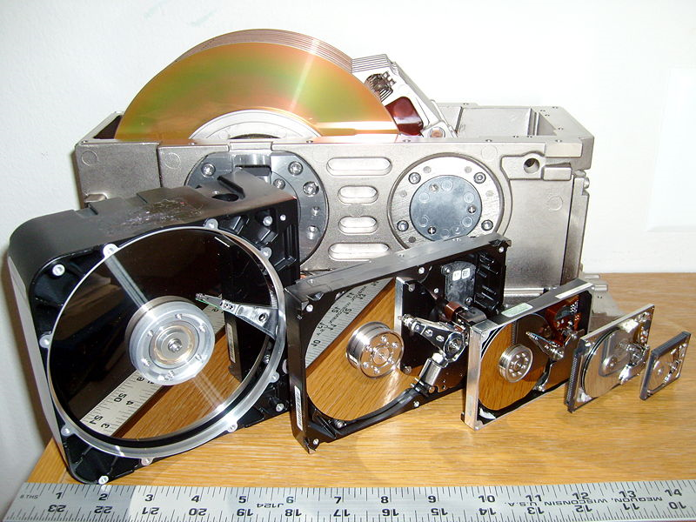
Hard Drives
Six hard disk drives with cases opened showing platters and heads; 8, 5.25, 3.5, 2.5, 1.8, and 1 inch disk diameters are represented.
Author | Paul R. Potts

Slide 8
Disk Drives
You are only as fast as your slowest or narrowest pipe, hard drives.
To feed other parts of the system we have to add lots of drives to get the desired IO single server can consume.
The problem isn’t size is speed.
Time | Circa 1981 | Today | Improvement
Capacity | 10MB | 1470MB | 147x
HDD Seeks | 85ms/seek | 3.3ms/seek | 20x
IO/Sec | 11.4 IO/Sec | 303 IO/Sec | 26x
HDD Throughput | 5mbit/sec | 1000mbit/sec | 200x
CPU Speed | 8088 4.77Mhz (.33 MIPS) | Core i7 965(18322 MIPS) | 5521x
Notes:
Everyone is familiar with Moore’s law (Often quoted, rarely understood) loosely applied says CPU transistor counts double roughly every 24 months. Hard disks haven’t come close to keeping up with that pace, performance wise.
Up until recently, hard drive capacity has been growing almost at the same rate doubling in size around every 18 months (Kryder’s Law). The problem isn’t size is speed.

Slide 9
Physical Structures
Head/Sectors/Cylinders
  Not a true physical representation!
Data/Track Placement
  Outside tracks pack more data = more MB/Sec
  Inside tracks seek faster = more I/O Sec
  More platters don’t = more speed!
    Current HDD only have one read/write channel
Doesn’t Apply to Solid State Disk!
Notes:
If the disk arms were controlled by multiple voice coils and there were many read/write channels platters would = speed.

Slide 10
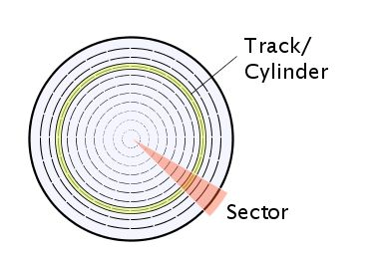
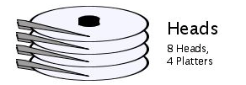
Track Placement
Track is in Yellow, Sector is in Red and Cylinder is through the disks

Slide 11
Disk Performance
Typical 73 GB SAS/SCSI Speeds
  Rotational Speed - 15,000 RPM
  Avg. Seek for random I/O’s – Real world 5.5 ms read, 6.0ms write Theoretical 2.9 ms read, 3.3 write
  Transfer Rate – Sequential 65MB ~ 120MB/Sec
  Transfer Rate – Random 10MB ~ 30MB/Sec
    Cache can effect this block size effects this 4~64k
  Track to Track Seek for sequential I/O’s– 0.5ms read, 0.7 ms write
  Rotational Latency - 2.0 ms

Slide 12
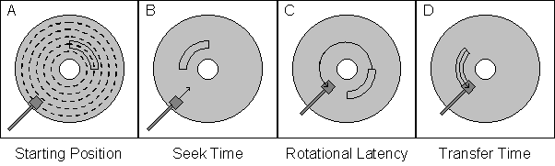
Latencies
Seek Time | The time required to move the read/write heads over the disk surface to the required track. The seek time is roughly proportional to the distance the heads must move.
Rotational Latency | The time taken, after the completion of the seek, for the disk platter to spin until the first sector addressed passes under the read/write heads. On average, the rotational latency is half of a full rotation.
Transfer Time | The time taken for the disk platter to spin until all the addressed sectors have passed under the heads.
Spindle Speed(RPM) | Average Latency (ms) | Typical Current Applications
5,400 | 5.6 | IDE Desktop/Laptop
7,200 | 4.2 | Current Standard IDE/SATA
10,000 | 3 | High end SATA Standard SAS/SCSI
15,000 | 2 | Current Maximum SAS/SCSI
Notes:
Seek Time Of course, if the heads happen to be over the correct track already, then there is no seek time.
Rotational Latency,
Transfer Time Of course, the transfer time is directly proportional to the number of sectors addressed.

Slide 13
Calculating Max Random Seeks/Sec
Maximum Random Seeks / sec
    1000 / (seek time[ms] + latency[ms])= IOps
    1000 / (2.9+2.0) = 204 Reads/Sec
    1000 /(3.3+2.0) = 188 Writes/Sec
Queuing effects latency!

Slide 14
Maximum Utilization for Best Performance
Maximum Write Seeks per second = 188
Knee of Curve at 80%
Configure for 140 I/Os per second per disk for random I/O’s
This is 75% of maximum capacity
Keeps latency low!

Slide 15
Sequential vs. Random I/Os
Sequential I/O is much faster
  Seek time 5.5 ms → 0.7 ms
  Same calculation yields 370 I/Os per sec
  or 277 I/Os per sec @ 75%
  > 300+ I/O’s per sec is common for sequential
As I/Os increase so does Latency
Sequential disk throughput can be close to SSD’s throughput.

Slide 16
Solid State Disks
No moving parts, IO’s measured in Microseconds!
  So, random IO is 200x or better than HDD
Reads faster than writes, generally
  As much as 4 to 1 depending on the manufacturer
Wear differently than HDD
  Can loose capacity over time
  Can slow down due to wear leveling
  Several layers of error correction
Expensive
  SAS 15k drive $2.00/GB
  SSD $8.00/GB
Doesn’t have to be a HDD form factor!

Slide 17
Solid State Disks
How Does A Hard Drive Stack Up to a Solid State Disk?
Performance | HDD | SSD | Improvement
Seek Times | 3.3ms/seek | 85μs/seek | 388x
I/O/Sec | 303 | 35000 | 115x
MB/Sec | 100 | 250 | 2.5x
Not all SSD’s are created equal
  Intel x25-M priced at 750.00 for 160GB in a 2.5” SATA 3.0 form factor and the Fusion-io ioDrive Duo 640GB model priced at 15000.00 in a PCIe 8x single card.
  why not SLC? Budget wise this is squarely in the realm of possibility.

Slide 18
Solid State Disk
Mainstream SSD Compared to PCIe Drive
Drive | GB | Write MB/Sec | Read MB /sec | Reads /sec | Writes /Sec | seek | WL/D | $ | $/GB | $/Read | $/Write
IoDrive Duo | 640 | 1GB | 1.4GB | 127K | 181K | 80μs | 5TB | $15k | $25.39 | $0.11 | $0.08
X25-M | 160 | 70MB | 250MB | 35k | 3.3k | 85μs | 100GB | $750 | $4.60 | $0.02 | $0.22
Imp. | -4x | -14x | -5x | -4x | -55x | ~ | -10x | -20x | -5x | -5x | 3x

Slide 19
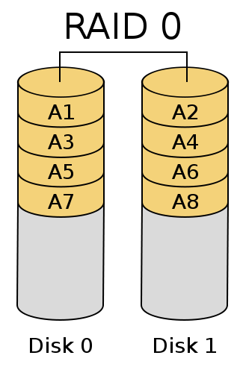
RAID 0 - a.k.a. Striping
Requires two or more disks.
No lost drive space due to striping.
Fastest read and write performance.
Offers no data protection.
The more disks, the more risk.

Slide 20
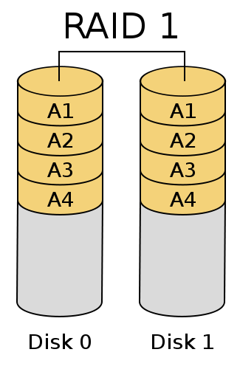
RAID 1 - a.k.a. Mirroring
Two disk only
Write speed of one disk
Read speed of two disk
Capacity is equal to the size of one disk

Slide 21
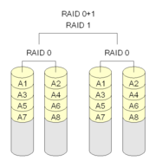
RAID 0+1 - Mirroring Two RAID 0 Stripes
Requires 4 or more drives
Is a mirror of two raid zero stripes
Can loose two drives and still function
Only half the space is available
Not the same as RAID 10

Slide 22
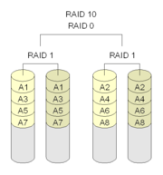
RAID 10 - Striping Two RAID 1 Mirrors
Best write and read performance
Requires 4 or more drives
Is a set of mirrors striped
Can loose n/2 drives where in is the total number of drives in the array
Only half the capacity is available

Slide 23
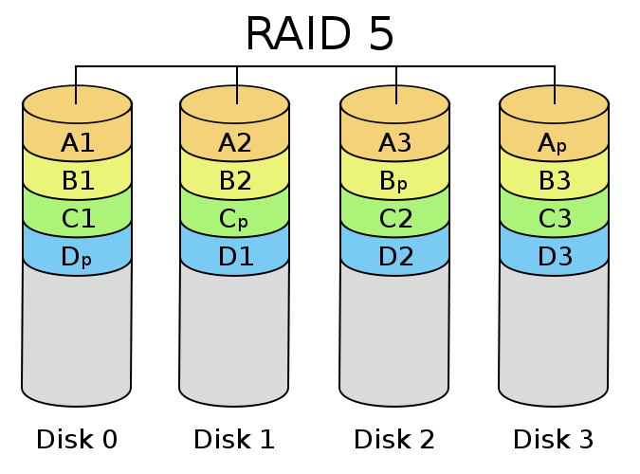
RAID 5 - Striping with Parity
Considered best compromise
Requires 3 or more drives
Stripe across all drives with parity
Can loose 1 drive and still function
Capacity is n-1 where n is number of drives in array

Slide 24
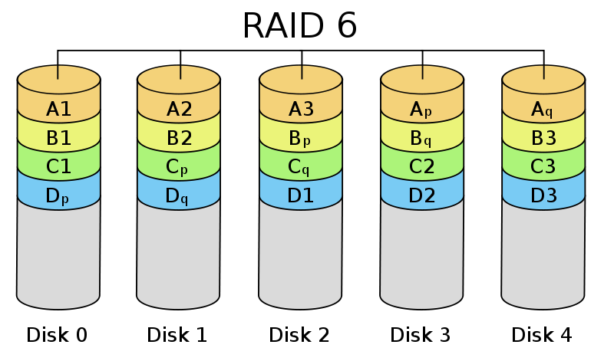
RAID 6 - RAID 5 on Steroids
Double raid 5 protection
4 or more disk
Is a stripe with two parity drives
Can loose two drives and still function
Capacity is n-2 where n is number of drives in array

Slide 25
Capacity or Performance?
Raid 0
  1 IOP read 1 IOP write
  No data protection
Raid 1
  1 IOP read 2 IOP write
  Both disk are written to both and both disk are read from
    Caveat depending on manufacturers implementation can be 2 IOP read or fastest seek
Raid 0+1
  1 IOP read 2 IOP write
Raid 10
  1 IOP read 2 IOP write
Raid 5
  1 IOP read 4 IOP write
  Both the target stripe and the parity stripe must be read and the parity calculated then both stripes must be written out
    Caveat reads can be as fast as n-1 disk
Raid 6
  1 IOP read 6 IOP write
  Both the target stripe and the two parity stripes must be read and the parity calculated then all three stripes must be written out
    Caveat read can be as fast as n-2 disk

Slide 26
Managing Disk Failures
Raid 0 = Data gone! More disk more risk!
Raid 1 = Twice the reliability
Raid 5 = Reliability at small scale more disk = higher risk!
Raid 6 = Reliability at large scale more GB = more risk
Raid 10 = Reliability at any scale susceptible to correlated disk failures
Calculating failure rates is complicated!
  Rule of thumb, more than 8 drives in a RAID 5 could be disastrous
  Uncorrectable read rate on large drives 1TB is a real danger!
  Disks from the same batch suffer similar fate (correlated failures)
Turn on torn page for 2000 and checksum for 2005/8!
Restore Backups regularly.
  It’s a recovery plan not a backup plan….

Slide 27
Configuring and Choosing Your RAID Level
SQL Server data files
  8k pages
  64k extents
  256k read ahead
RAID cluster size should be set to 64k or 256k
  Start at 64k cluster size
  Move to 256k cluster size for better sequential throughput
  Know your IO patterns!
  Generally 256k fits 99% of your needs
Separate IO types!
  Data files tend to be random reads/writes
  Log files have zero random reads/writes
    More than one log on a drive = random reads/writes!
    Better Than Putting Logs With Data Though
  Separate LUN’s with no shared disk!
Raid 1 or 10 for logs
  Heavy write load demands it
Raid 5, 6 or 10 for data
  More than 10% writes you should start looking at raid 10
    Understand writes incur reads!
Notes:
Understand writes generate reads. Seeks to insert update or delete data require reads.

Slide 28
Stripe Size, Block Size, and IO Patterns
Physical disk sectors 512,4096
  Can’t restore or attach larger sector size on a smaller sector size disk. 1024 can go on a 512 but not 512 on a 1024
  Be aware of possible performance penalties
It doesn’t add up
  10 drives at 80MB/sec != 800MB/sec
  Rule of thumb 15 MB/sec per drive
RAID Array Configuration
  Stripe size and IO request size determine throughput
  Small stripes + large IO request = split IO’s
  SQL Server works mostly in 8K and 64K blocks

Slide 29
SAN Basics
Storage Area Network
  Essentially a specialized computer system
  Specialized network using Fibre Channel or Ethernet
  Great for redundancy or clustering
  Focused on storage consolidation not storage speed
  NAS is not a SAN!
Internal Disk Configuration
  Disks are broken up into slices
  Slices are grouped into Logical Unit Numbers (LUNs)
    These are presented as volumes to your host
  Size for IO loads not disk space!
  Don’t share your disks with other applications like Exchange
    You and your Exchange admin will both be very sad
  Watch for hot spots

Slide 30
SQL Server and The File System
ACID and WAL
  ACID (Atomicity, Consistency, Isolation, and Durability) is what makes our database reliable. The ability to recover from a catastrophic failure is key to protecting your data.
  WAL (Write-Ahead Logging) is how ACID is achieved. Basically, the log record must be flushed to disk before the data file is modified.
Stable Media
  Stable media isn’t just the disk drive. A controller with a battery backed cache is also considered stable.
FUA (Forced Unit Access)
  FILE_FLAG_WRITETHROUGH tells the underlying OS not to use write caching that isn’t considered stable media.
  FILE_FLAG_NO_BUFFERING tells the OS not to buffer the file ether.
  At this point the only cache available will be the battery backed or other durable cached on the controller.
File Access
  SQL Server uses asynchronous access for data and log files.
  SQL Server will try and gather writes to the data file into bigger blocks but the log is always written to sequentially.
All of these rules apply to everything but tempdb. Since tempdb is recreated at restart every time recoverability isn’t an issue.

Slide 31
SQL Server and The File System
Format data partitions to 64k cluster size for performance. SQL Server reads in 64k chunks if possible
Sector alignment to prevent split I/O’s
MBR occupies the first 63 sectors leaving your partition starting on the 64th
Use diskpar (windows 2000/2003 pre sp1)
Use diskpart (windows 2003 sp1 or greater)
Windows 2008 aligns out of the box on 1MB
Disk defrag will not fix this!
Full partition format will not fix this!

Slide 32
Monitoring Performance
Response Time = Service Time + Wait Time
Forget Disk Queue Length
  More relevant 10 year ago than today
  Caches mask DQ, SSD’s behave differently
Focus on latency and waits
  sys.dm_io_virtual_file_stats
    Gives you time to read and write IO’s
    Gives you amount of data written and read at the file level
    Great for finding SAN hot spots
  sys.dm_os_wait_stats
    Gives you what SQL Server is doing besides IO
    Only at a instance level

Slide 33
QUESTIONS?
?
Notes:
That big question mark is editable – use whatever character you want!

Slide 34
SQL Saturday #57 Houston
Understanding Storage Systems and SQL Server
Wesley Brown
wes@planetarydb.com
Twitter @WesBrownSQL
Blog http://www.sqlserverio.com
http://www.wesworld.net/raidcalculator.html

